Slide 1
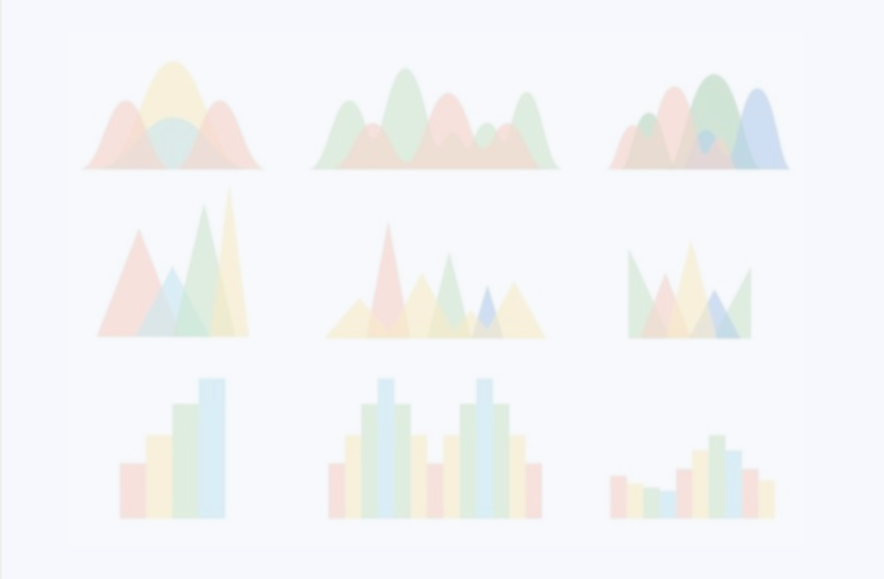
Discussion 13
Matplotlib

Slide 2
Tips and Review
Plot: Creates a 2 dimension (x vs y axes) figure or line plot
Subplot: Divides the current figure into row, column, and the figure position.
subplot(221)
subplot(222)
subplot(223)
subplot(224)
E.g.: In a figure divided into 2 rows and 2 columns, the yellow rectangle (bottom left) is at 3rd position.

Slide 3
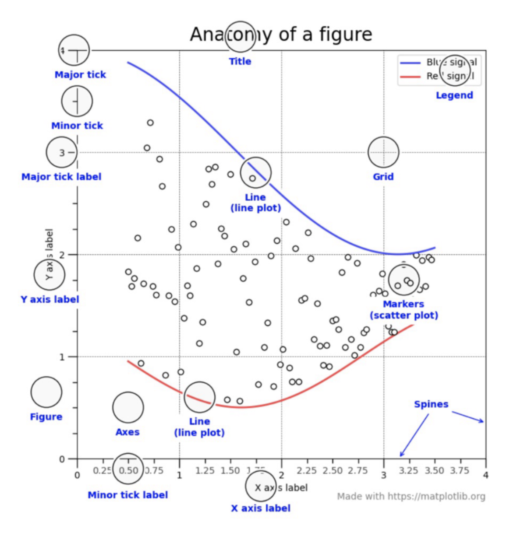
Tips and Review
Please refer to the lecture slides and the MATLAB documentation.
We have provided you with an amazing cheat sheet that can help you greatly with your project and take it to the next level.
Different elements of plotting

Slide 4
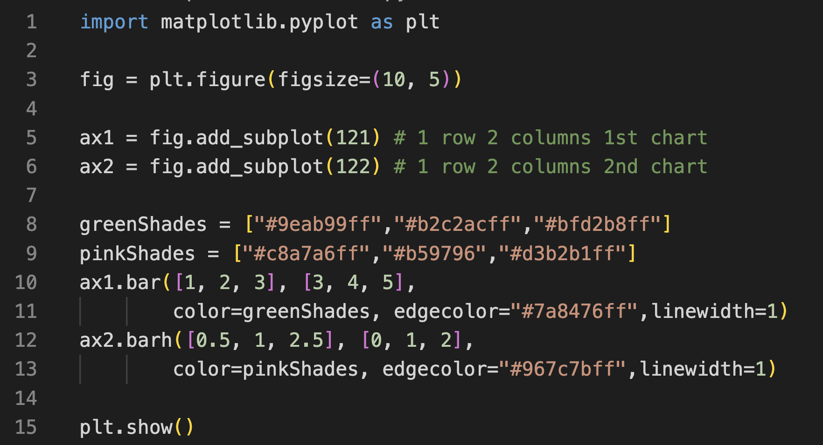
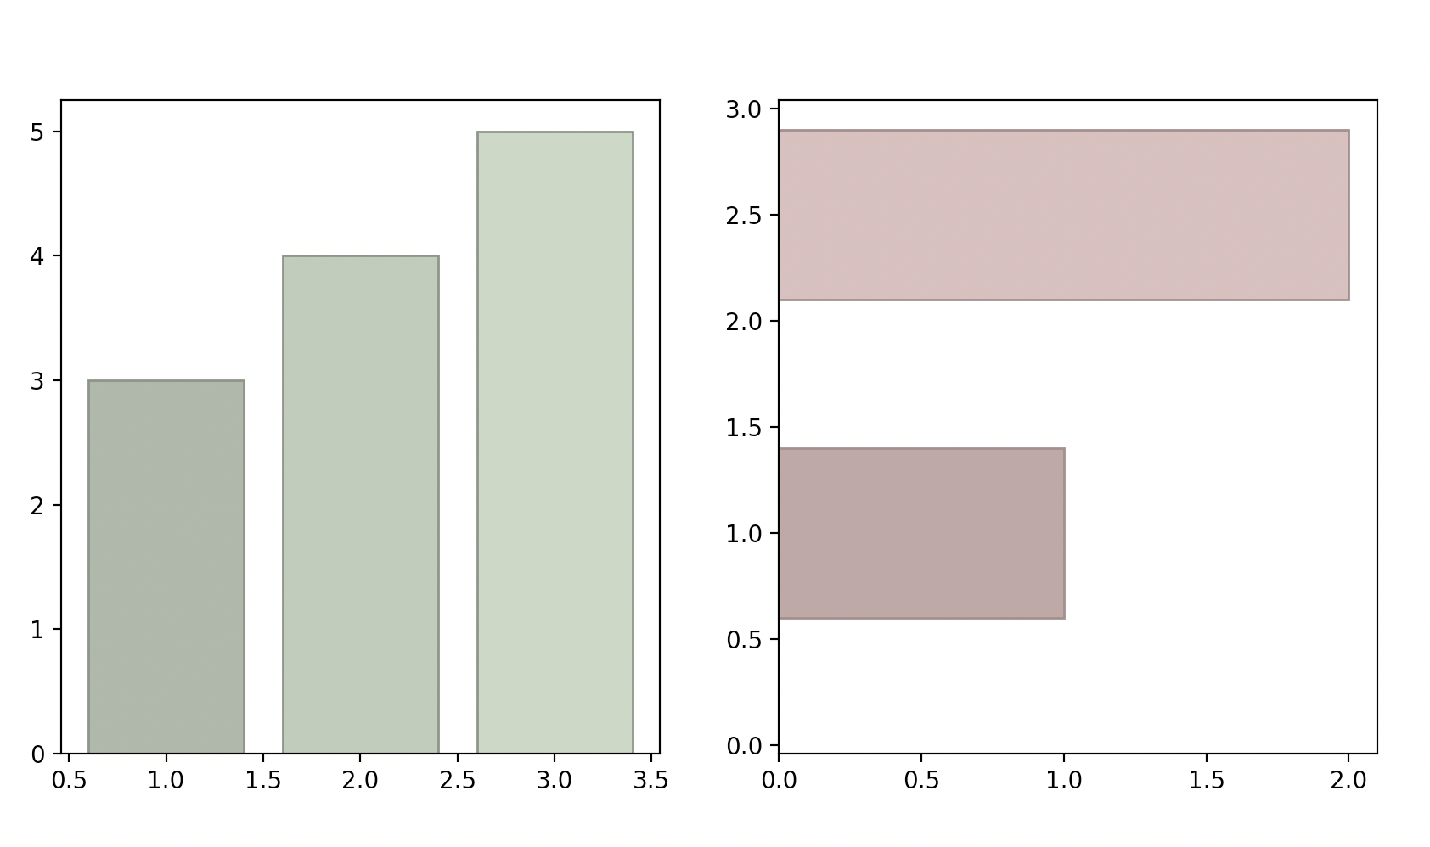
Plotting Subplots
You can also use plt.subplot(121)

Slide 5
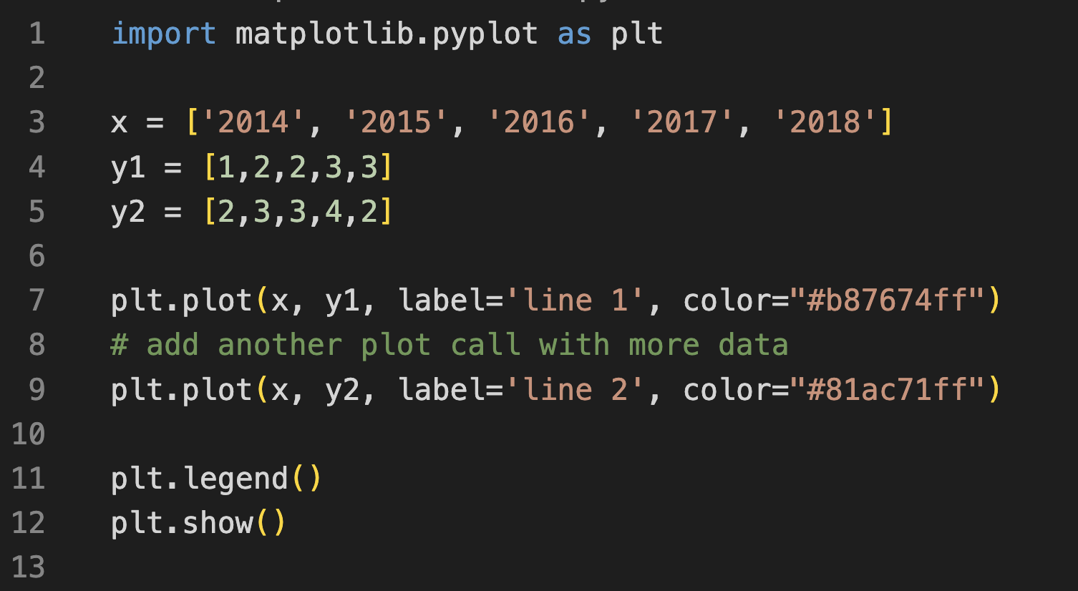
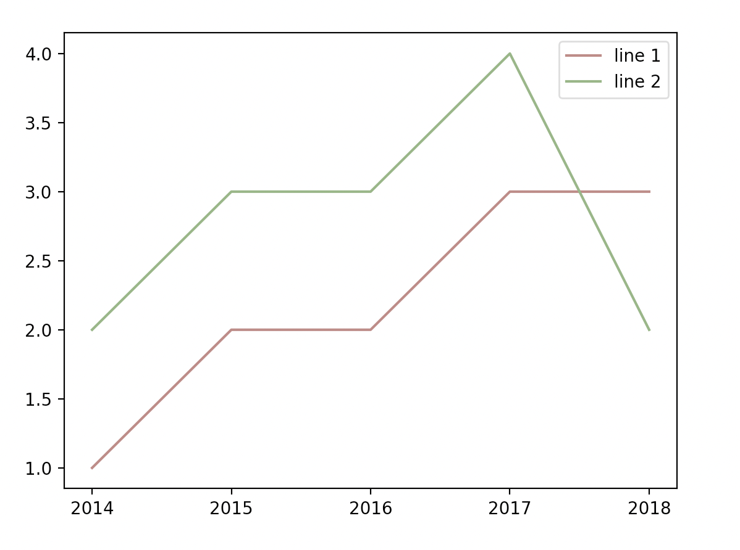
Plotting Lines

Slide 6
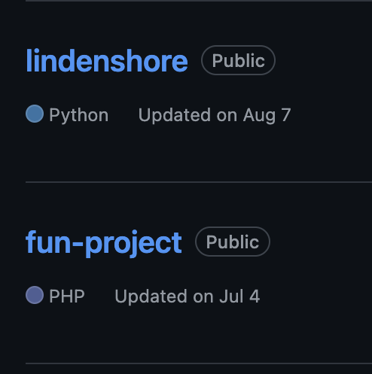
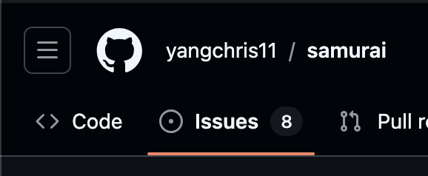
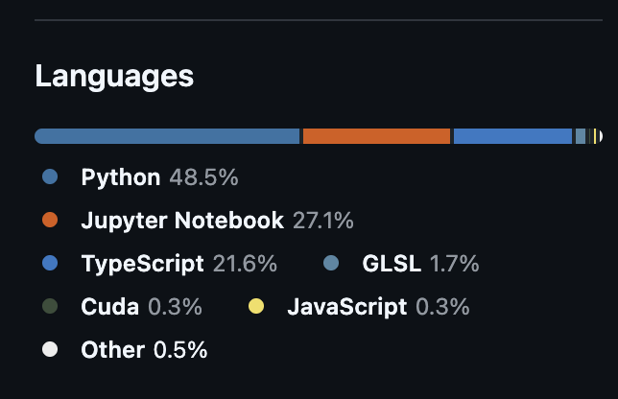
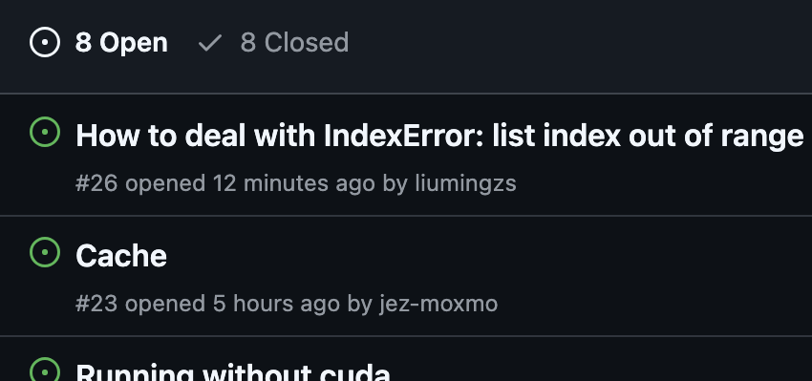
Today’s Tasks
Each of the many repositories on GitHub uses diverse coding languages and utilizes issues from different developers and users.
Samples of coding languages used in GitHub
Samples of issues for a single repository

Slide 7
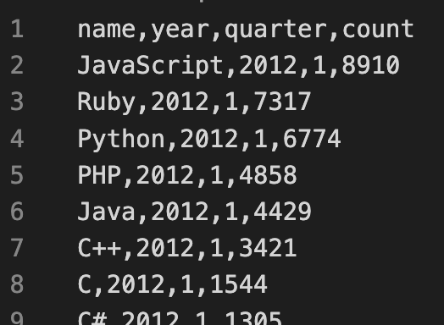
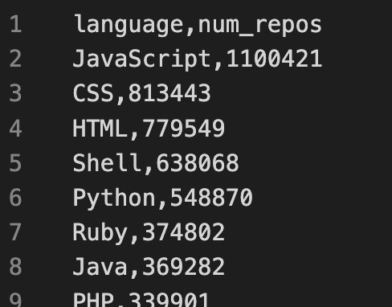
Today’s Tasks
You are given two CSV files representing these diverse coding languages and issues used in thousands of such GitHub repositories.
issues.csv
repos.csv
We will be plotting this data!

Slide 8
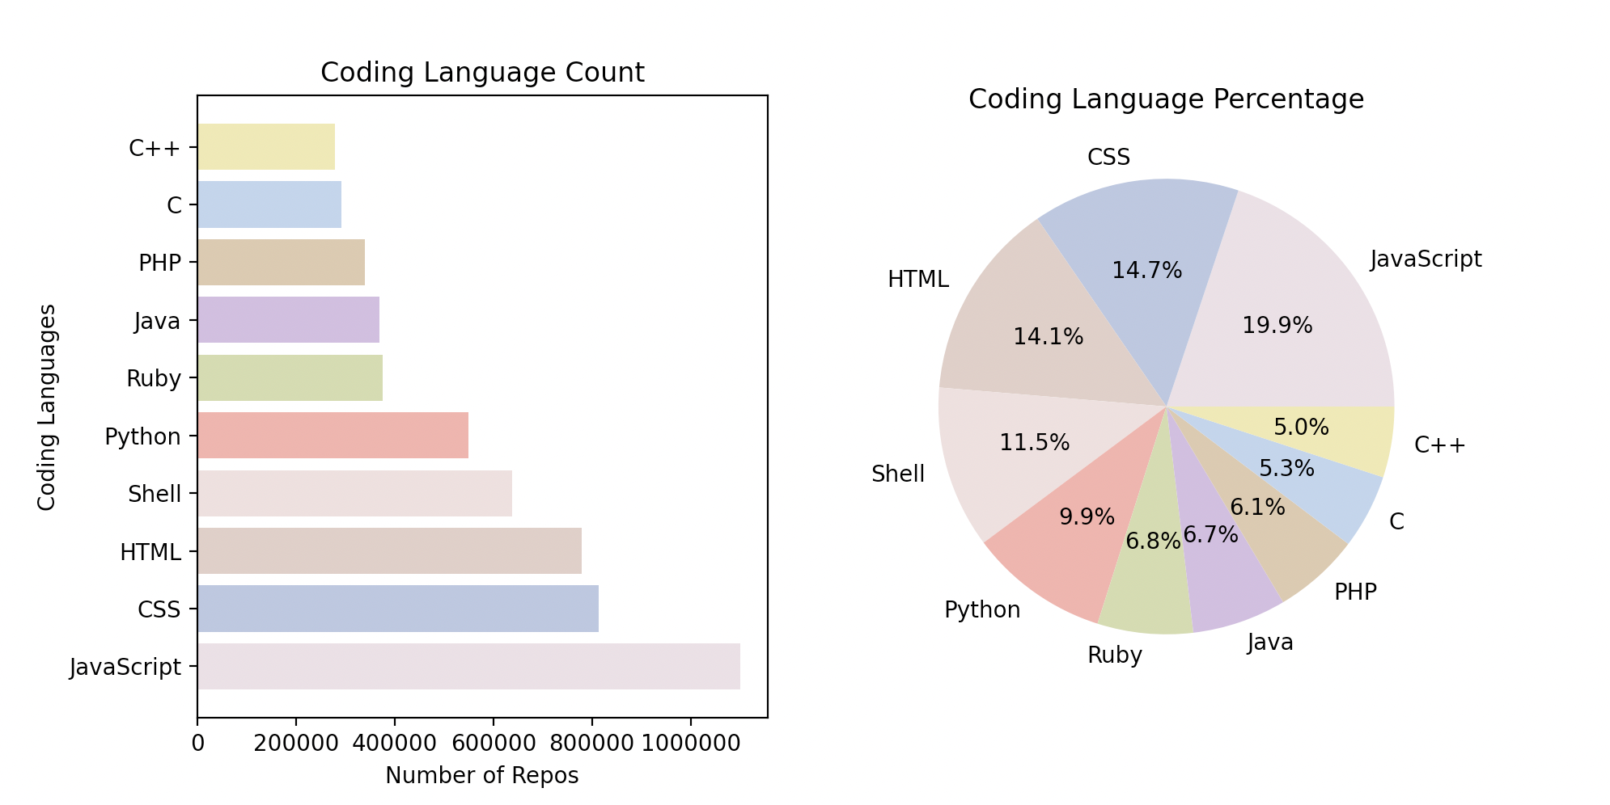
Today’s Tasks
Generate one plot with two subplots side by side:
Left subplot: a horizontal bar chart. Coding languages v.s. Number of repos
Right subplot: a bar chart where each portion represents a coding language.

Slide 9
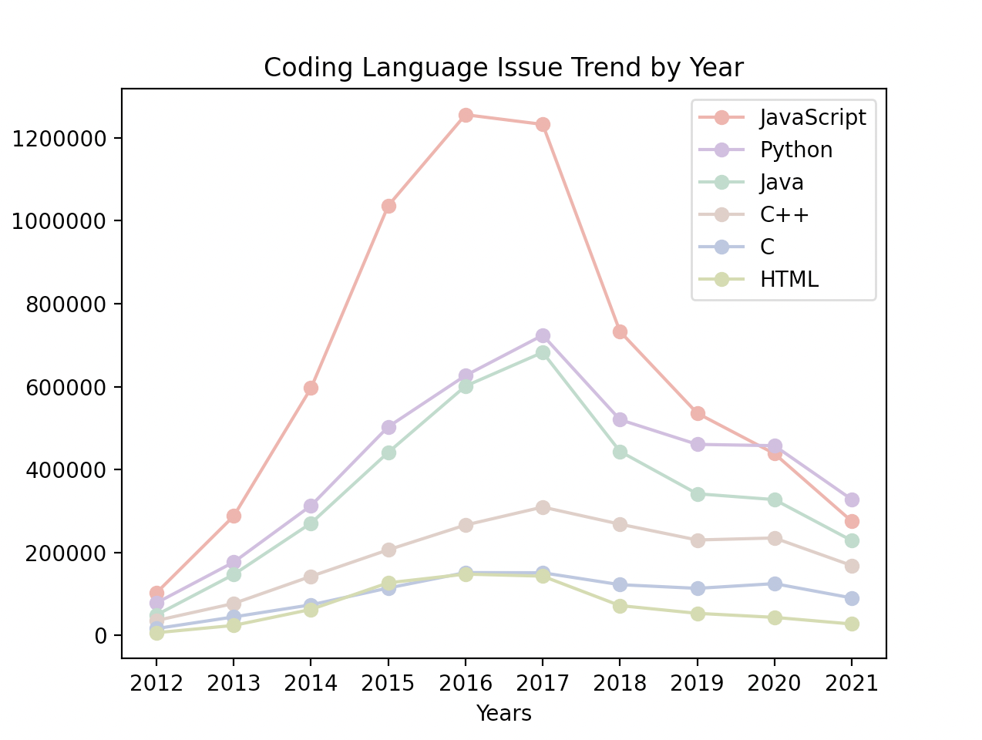
Today’s Tasks
Generate a multi-line chart. Year v.s. Number of Issues (by languages)

